Slide 1

AI-ML Virtual Internship
by
BHARGAVI P
Roll No : 204G1A3204
Department of Computer Science and Engineering (Data Science)
Srinivasa Ramanujan Institute of Technology
Autonomous
Rotarypuram Village, B K Samudram Mandal, Ananthapuramu – 515701.
2023-2024

Slide 2

Contents
Introduction
Modules
Modules Explanation
Conclusion
References

Slide 3
Introduction
AWS Academy Cloud Foundations
Provides a brief over view of principles of Cloud, AWS core services, security, architecture, pricing and support, AWS well architecture format.
AWS Academy Machine Learning Foundation
Presents fundamental AI and Machine Learning concepts.
Provides hands-on experience in labeling, building, training, and deploying
custom machine learning models.
From EduSkills Foundation, AICTE launches a Virtual Internship on AI-ML.
The main aim of this is to gain insights into cutting-edge cloud and AI
technologies.

Slide 4
Modules
Cloud Concepts Overview
Cloud Economics and Billing
AWS Global Infrastructure Overview
AWS Cloud Security
Networking and Content Delivery
Compute
Storage
Databases
Cloud Architecture
Automatic Scaling and Monitoring

Slide 5
Modules (Contd…)
Welcome To AWS Academy Machine Learning Foundations
Introducing Machine Learning
Implementing a Machine Learning Pipeline with Amazon Sagemaker
Introducing Forecasting
Introducing Computer Vision
Introducing Natural Language Processing

Slide 6
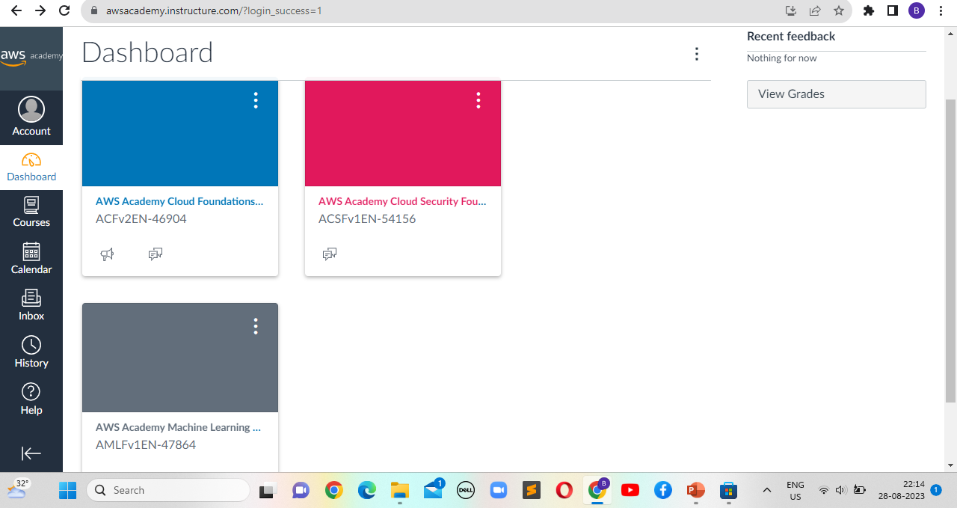
Dashboard

Slide 7
Cloud Concepts Overview
Cloud Computing: Cloud computing is the delivery of computing services (such as storage, processing power, databases, networking, software, and more) over the internet. Users can access these resources on-demand, without the need for physical infrastructure.
Service Models: Cloud computing offers various service models that define the level of control and responsibility a user has over the cloud resources. The common service models are:
Infrastructure as a Service (IaaS): Provides virtualized computing resources over the internet. Users can rent virtual machines, storage, and networking components.
Platform as a Service (PaaS): Offers a platform that includes hardware and software tools for application development, testing, and deployment.
Software as a Service (SaaS): Delivers software applications over the internet, eliminating the need for installation and maintenance on the user's end.

Slide 8
Cloud Economics and Billing
Three Fundamental Cost Drivers with AWS
Compute - charged by use time, varies by instance
Storage - charged per GB
Data Transfer - outbound transfers are aggregated and charged per GB
Billing
AWS Organizations: An account management service that enables you to consolidate multiple AWS accounts into an organization that you create and centrally manage.
Key Features and Benefits
Policy based account management
Group based account management
Consolidated billing

Slide 9
AWS Global Infrastructure Overview
The AWS Global Infrastructure is designed and built to deliver a flexible, scalable, and secure cloud computing environment.
AWS Regions
An AWS Region is a geographical area.
Communication between Regions uses AWS backbone network infrastructure.
A Region typically consists of two or more Availability Zones.
AWS Infrastructure Features
First, it is elastic and scalable. This means resources can dynamically adjust to increases or decreases in capacity requirements. It can also rapidly adjust to accommodate growth.
Second, this infrastructure is fault tolerant, which means it has built-in component redundancy which enables it to continue operations despite a failed component.
Finally, it requires minimal to no human intervention, while providing high availability with minimal down time.

Slide 10
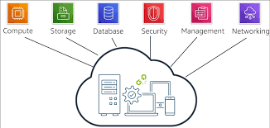
AWS Cloud Security
AWS is responsible for protecting the infrastructure that runs all the services that are offered in the AWS Cloud.
The customer is responsible for the encryption of data at rest and data in transit.
AWS Identity and Access Management (IAM)
Allows to control access to compute, storage, database, and application services in the AWS Cloud. IAM can be used to handle authentication, and to specify and enforce authorization policies to specify which users can access which services.

Slide 11
Networking and Content Delivery
Networks : A computer network is two or more client machines that are connected together to share resources.
Amazon VPC
Amazon VPC gives control over virtual networking resources, including the selection of own IP address range, the creation of subnets, and the configuration of route tables and network gateways.
VPC Networking
Internet Gateway : A scalable, redundant, and highly available VPC component that allows communication between instances in VPC and the public internet. An internet gateway serves two purposes
Provide a target in VPC route tables for internet traffic.
Perform network address translation for instances that were assigned public IPv4 addresses.

Slide 12
Compute
Compute resources lie at the heart of cloud computing, driving the processing power necessary for running applications, performing calculations, and executing tasks.
The cloud offers various compute options, ranging from Infrastructure as a Service (IaaS) that provides virtualized hardware resources, to Platform as a Service (PaaS) that offers a complete development platform, and Software as a Service (SaaS) that delivers fully functional applications over the web.

Slide 13
Storage
Amazon Elastic Block Store (EBS)
Amazon Elastic Block Store (EBS) is an easy to use, high performance block storage service designed for use with Amazon Elastic Compute Cloud (EC2) for both throughput and transaction intensive workloads at any scale.
Amazon Simple Storage Service (S3)
Data is stored as objects in buckets.
Virtually unlimited storage but a single object is limited to 5 TB .
Granular access to bucket and objects

Slide 14
Databases
Databases are the backbone of modern applications, enabling the structured storage, retrieval, and management of data.
Cloud computing has revolutionized the database landscape, offering a variety of database services that cater to diverse needs, providing scalability, availability, and manageability that were once challenging to achieve with traditional on-premises solutions.
Cloud database services encompass a wide range of options. Relational database services like Amazon RDS, Azure SQL Database, and Google Cloud SQL simplify the management of traditional SQL databases, handling backups, scaling, and maintenance tasks.

Slide 15
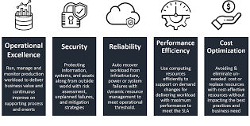
Cloud Architecture
AWS Well-Architected Framework
The AWS Well Architected Framework is a guide that is designed to help us build the most secure, high-performing, resilient, and efficient infrastructure possible for cloud applications and workloads.
The AWS Well-Architected Framework is organized into five pillars

Slide 16
Automatic Scaling and Monitoring
Auto scaling is a critical component of cloud architecture that allows applications to dynamically adjust their resource capacity based on workload demand.
Key Concepts:
Horizontal Scaling: Auto scaling typically involves adding or removing instances (such as virtual machines or containers) to match the changing load. This is known as horizontal scaling.
Scaling Policies: Auto scaling policies define rules for scaling actions. They specify conditions that trigger scaling actions, such as CPU utilization exceeding a certain threshold.
Cooldown Period: After a scaling action, there is a cooldown period during which additional scaling actions are not triggered. This prevents rapid and unnecessary scaling.
Scheduled Scaling: Some applications experience predictable spikes in traffic. Scheduled scaling allows you to automatically adjust resources based on a predefined schedule.

Slide 17
Introducing Machine Learning
Machine Learning : Machine learning is a subset of AI, which is a broad branch of computer science for building machines that can do human tasks. Deep learning itself a subdomain of machine learning.
Machine learning is the scientific study of algorithms and statistical models to perform a task by using inference instead of instructions
Types of Machine Learning
Supervised learning, where a model uses known inputs and outputs to generalize future outputs.
Unsupervised learning, where the model doesn’t know inputs or outputs it finds patterns in the data without help.
Reinforcement learning, where the model interacts with its environment and learns to take actions that maximize rewards.

Slide 18
Introducing Forecasting
Overview of forecasting
Forecasting is an important area of machine learning. It is like predicting future based on historical data.
Applications:
Marketing applications, such as sales forecasting.
Energy consumption to determine when and where energy is needed.
Weather forecasting systems for governments, and commercial applications.
Using Amazon Forecast
Amazon Forecast inspects the data, identifies key data, and selects an appropriate algorithm.
It uses the algorithm to train and optimize a custom model and produce a predictor.

Slide 19
Introducing Computer Vision
Computer Vision is the automated extraction of information from digital images. It lets machines accurately identify people, places, and things faster than humans.
Use cases for Computer Vision
Public safety and home security
Computer vision with image and facial recognition can help to quickly identify unlawful entries or persons of interest, thereby enhancing security.
Autonomous driving
Computer vision enables safer self-driving cars for reliable autonomous transportation.
Medical imaging
Medical image analysis with computer vision can improve the accuracy and speed of a patient's medical diagnosis, which can result in better treatment outcomes and life expectancy.

Slide 20
Introducing Natural Language Processing
Natural Language Processing (NLP) is a branch of artificial intelligence that focuses on enabling computers to understand, interpret, and generate human language in a way that is both meaningful and valuable.
NLP encompasses a wide range of tasks and techniques, including:
Text Analysis: NLP techniques help analyze and extract insights from text data. This includes tasks like sentiment analysis and text classification.
Language Generation: NLP enables computers to generate human-like language, which finds applications in chatbots, text summarization, and content creation.
Speech Recognition: NLP algorithms convert spoken language into text, enabling voice assistants and transcription services.
Question Answering: NLP models can process questions and provide relevant answers based on large amounts of textual information.

Slide 21
Conclusion
The journey through cloud concepts, artificial intelligence, and machine learning has been truly eye-opening. AWS Academy Cloud Foundations teaches vital cloud knowledge, while the AWS Academy Machine Learning Foundation imparts practical AI and ML skills. Stepping into the world of AI and Machine Learning has shown us how to make machines smart, enabling automation and intelligent decision-making.

Slide 22
References
[1] https://internship.aicte-india.org/internshipbyeduskills.php
[2] https://awsacademy.instructure.com/courses

Slide 23
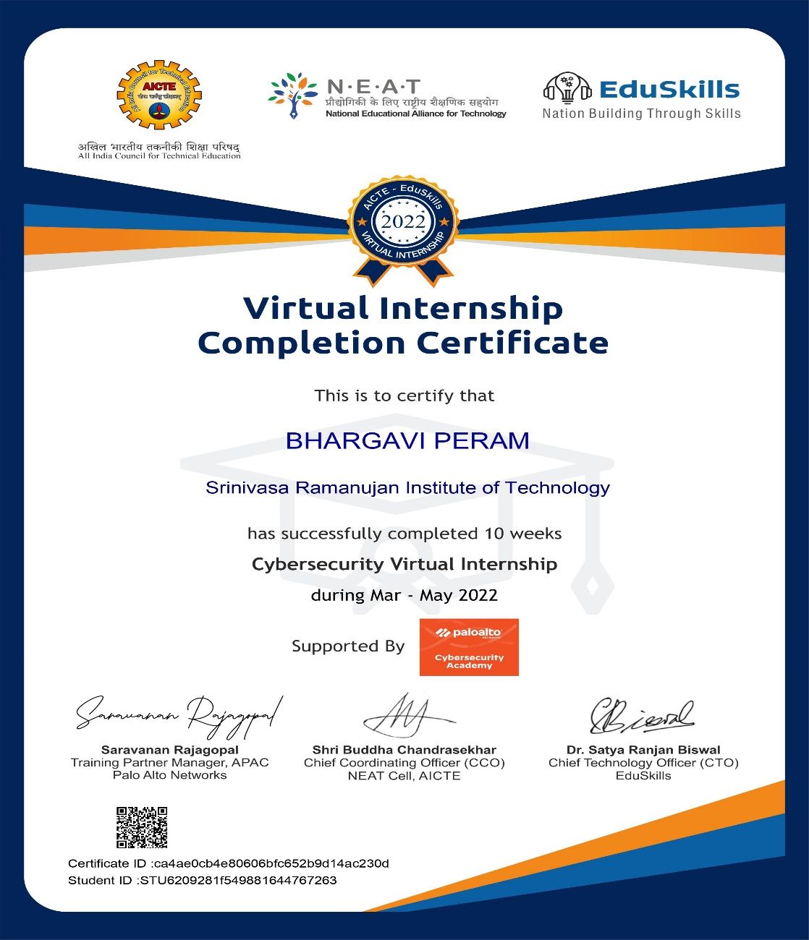
Internship Certificate

Slide 24
Thank You!!!

